Slide 1
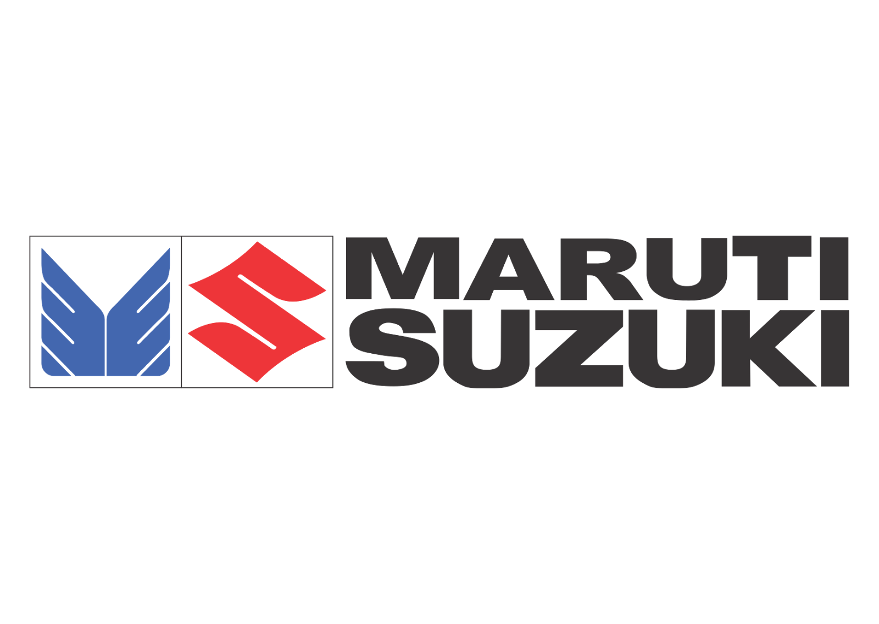
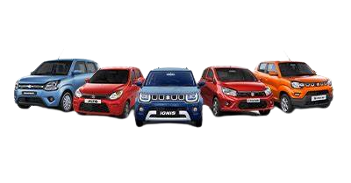
Comprehensive Digital Marketing
For Maruti Suzuki India Ltd

Slide 2
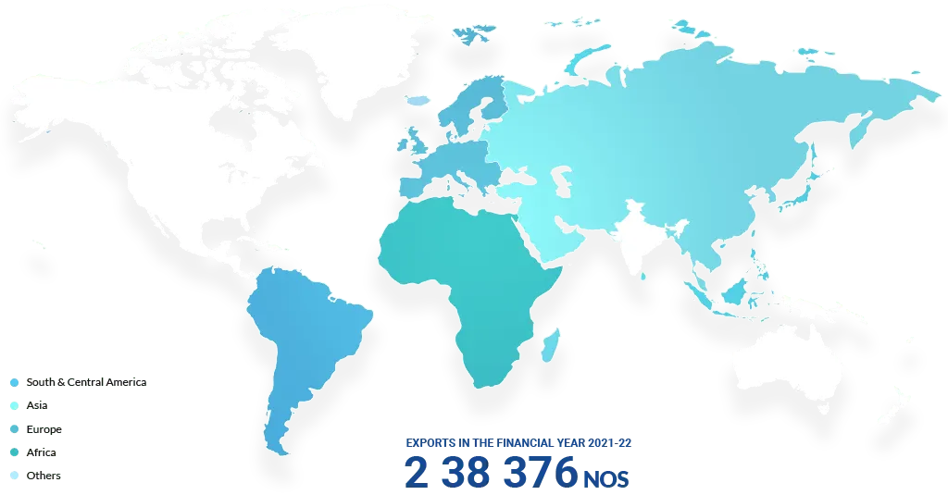
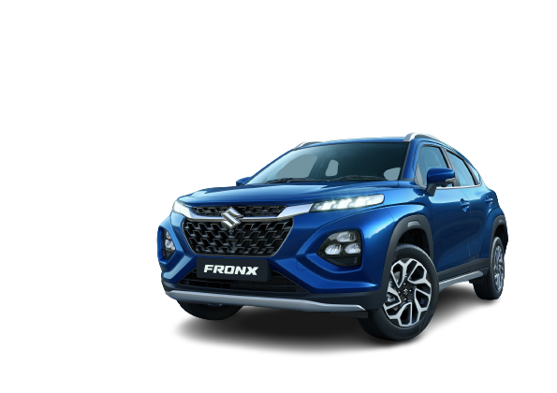
Maruti Suzuki Established 1981
Employee Strength 16,025
Vehicles Sold 1.97 million
Sales & Service Points 4,000

Slide 3



Mission
Vision
Tagline
With no mission statement mentioned as such, still brands mission since its inception has been “To motorize the country”
“The Leader in the Indian Automobile Industry, creating customer Delight and Shareholder’s wealth; A pride of India” Core Values of MUL
“Way of Life”

Slide 4
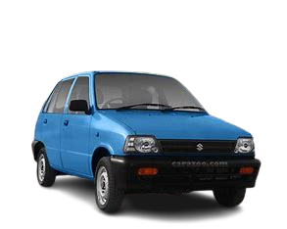
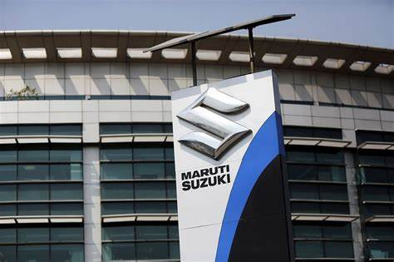
Brand Study
Maruti Suzuki was established in 1981 as a collaboration between the Indian government and Suzuki Motor Corporation of Japan. It was initially named Maruti Udyog Limited.
Key Milestones: Mention significant milestones in the company's history, such as the launch of the Maruti 800, India's first affordable small car, in 1983. This car played a pivotal role in making car ownership more accessible to the Indian middle class.
Suzuki's Involvement: Emphasize the role of Suzuki Motor Corporation in providing technical expertise and know-how, which helped Maruti Suzuki develop a strong foothold in the Indian automotive market.
Joint Venture: Discuss the nature of the joint venture between the Indian government and Suzuki, including details of shareholding and its evolution over the years.
Privatization: Mention the privatization of Maruti Suzuki in 2003, when the Indian government sold its remaining stake to Suzuki, making it a wholly-owned subsidiary of Suzuki.

Slide 5
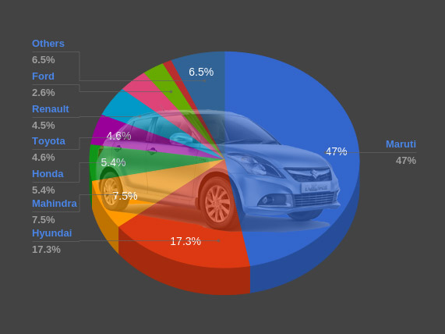
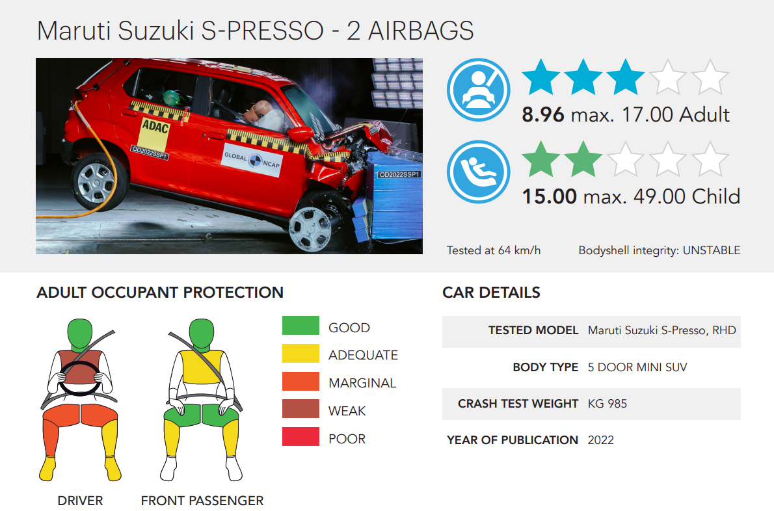
Maruti Suzuki India Limited is an Indian auto giant based in New Delhi, India. The company has a market share of 47% in the passenger car segment.
India’s most famous cars which include the likes of Maruti 800, Omni, Maruti Zen, the still popular Swift Dzire, and Maruti Gypsy, all have been born out of this company.
It has two manufacturing plants in Haryana (Gurgaon and Manesar) and one manufacturing complex in Gujarat which is wholly owned by its parent company Suzuki, which supplies the entire production to Maruti Suzuki. They have a combined manufacturing capacity of 2,250,000 vehicle units annually.
The company’s success secret lies in its ability to cater to the needs of the price-sensitive Indian middle-class consumers by delivering at low initials accompanied by economical maintenance costs.
The brand has a vast network of service stations and customer points across the nation which serve a huge number of cars daily. However, very few offerings from Maruti Suzuki have been able to score a rating exceeding 3.0 at any NCAP. Is this how the company is able to keep its costs low by compromising on safety aspects.

Slide 6
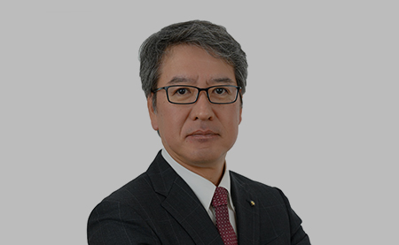
Quick Stats on Maruti Suzuki
CEO | MR. HISASHI TAKEUCHI
CMO | Shashank Srivastava
Area Served | India
Industry | Automobile
Market Share/ Revenue | INR 81,844 million
MR. HISASHI TAKEUCHI
The present CEO officer in India for Maruti Suzuki is Mr. Hisashi Takeuchi. He was appointed as the Managing Director and Chief Executive Officer of Maruti Suzuki India Limited (MSIL) with effect from April 1, 2022
Shashank Srivastava, the senior executive officer of marketing and sales at Maruti Suzuki India Limited, the largest automobile manufacturer in India. He is responsible for leading Maruti Suzuki into the future with exciting cars that are good for the customers, environment and society.

Slide 7
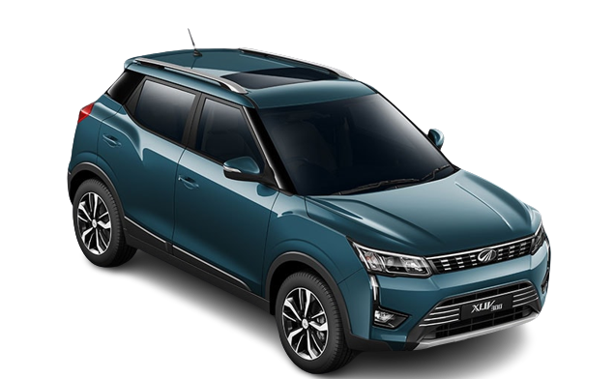
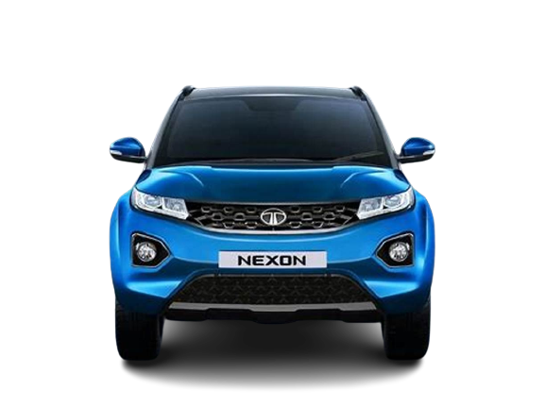
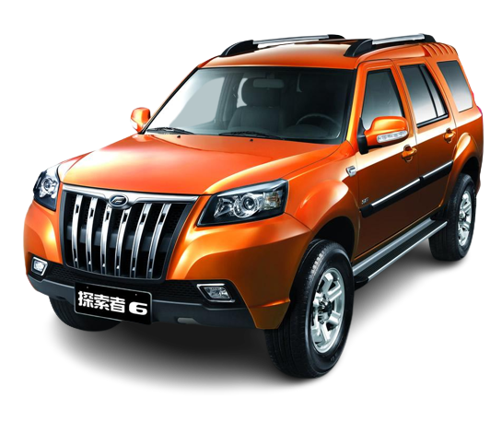
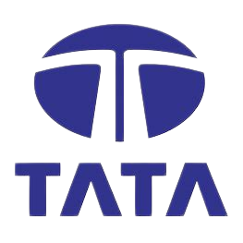
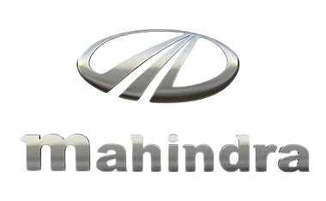

Competitor Analysis

Slide 8
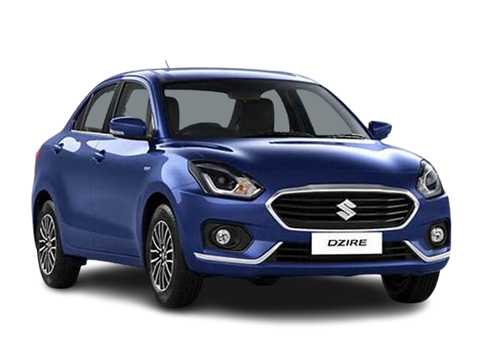
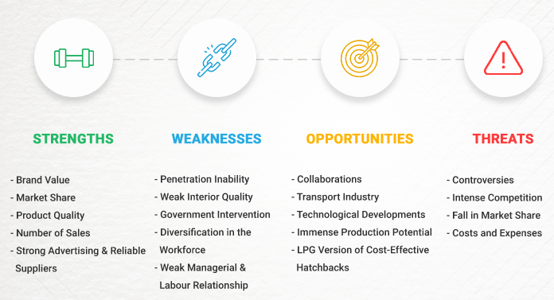
Swot Analysis of Maruti suzuki
SWOT Analysis of Maruti Suzuki can show how a well-established company uses its opportunities to ensure its growth.
It can show how the company takes advantage of its strengths to use the opportunities while working on its weaknesses. SWOT Analysis of Maruti Suzuki will also reveal its expansion plans.

Slide 9
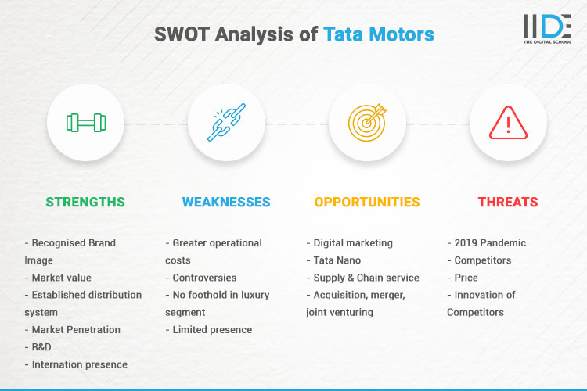
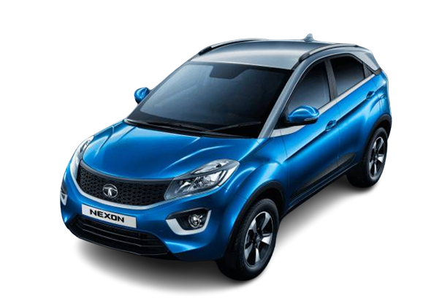
Swot Analysis of tata motors

Slide 10
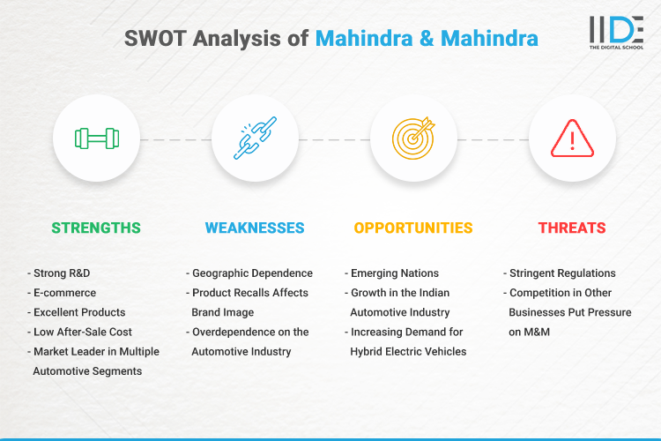
Swot Analysis of mahindra

Slide 11

Buyer’s/Audience’s PERSONA
Customer profile for the brand includes middle to high-income groups ranging from the ones.
Who are looking to switch from 2-wheeler to 4- wheeler to those.
Who are planning to buy the second car or a luxury car for their family.
It includes customers in the age bracket of 22-60 year and also high business professionals
Who are looking for low maintenance or innovative and trending world-class vehicles with advanced safety features.

Slide 12
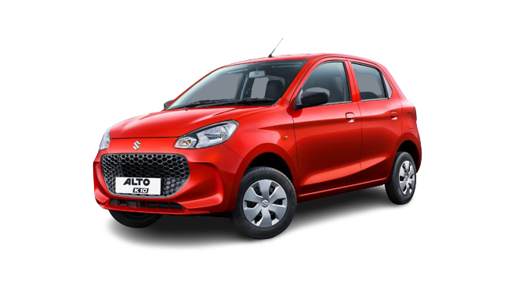
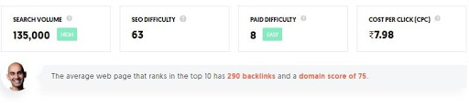
SEARCH ENGINE OPTIMISATION
Maruti is one of the most successful automobile companies in India has worked immensely on optimizing its platform to rank on the search engine.
Whenever someone searches for Keywords like “ Cars, Best Cars or anything related to Car and vehicles” the chances of results showing Maruti’s article are very high. And this is all possible because Maruti has put a lot of effort into SEO.
As per Uber suggest, a keyword tool by Neil Patel, Maruti has a search volume of 135000 while 55837 people click on SEO results in India.
The average web page that ranks in the top 10 has 290 backlinks and a domain score of 75. These stats are really amazing.

Slide 13
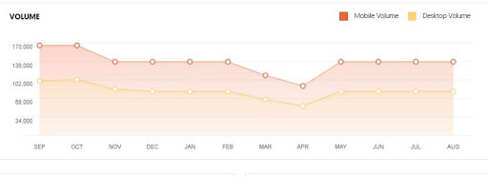
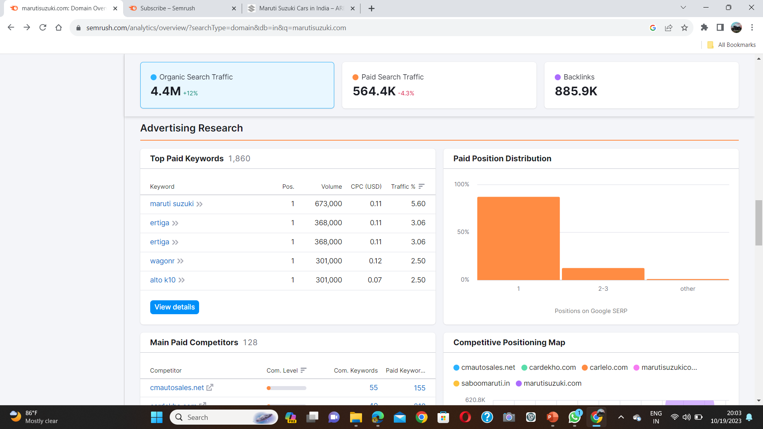
The graph below shows the monthly search volume of Maruti. As per the latest results in the month of August, Maruti had a total of 135000 searches, out of which 54726 were mobile searches while 80274 desktop searches.
Uber suggest gives an overall idea of keywords for which Maruti is being searched over the internet. The graph below shows different keywords and their search volume.
As you can see above, the keyword “Maruti Suzuki” has a search volume of 550000 which is followed by “Maruti share price” which has a volume of 450000. These are the top keywords related to Maruti that people search on the internet

Slide 14
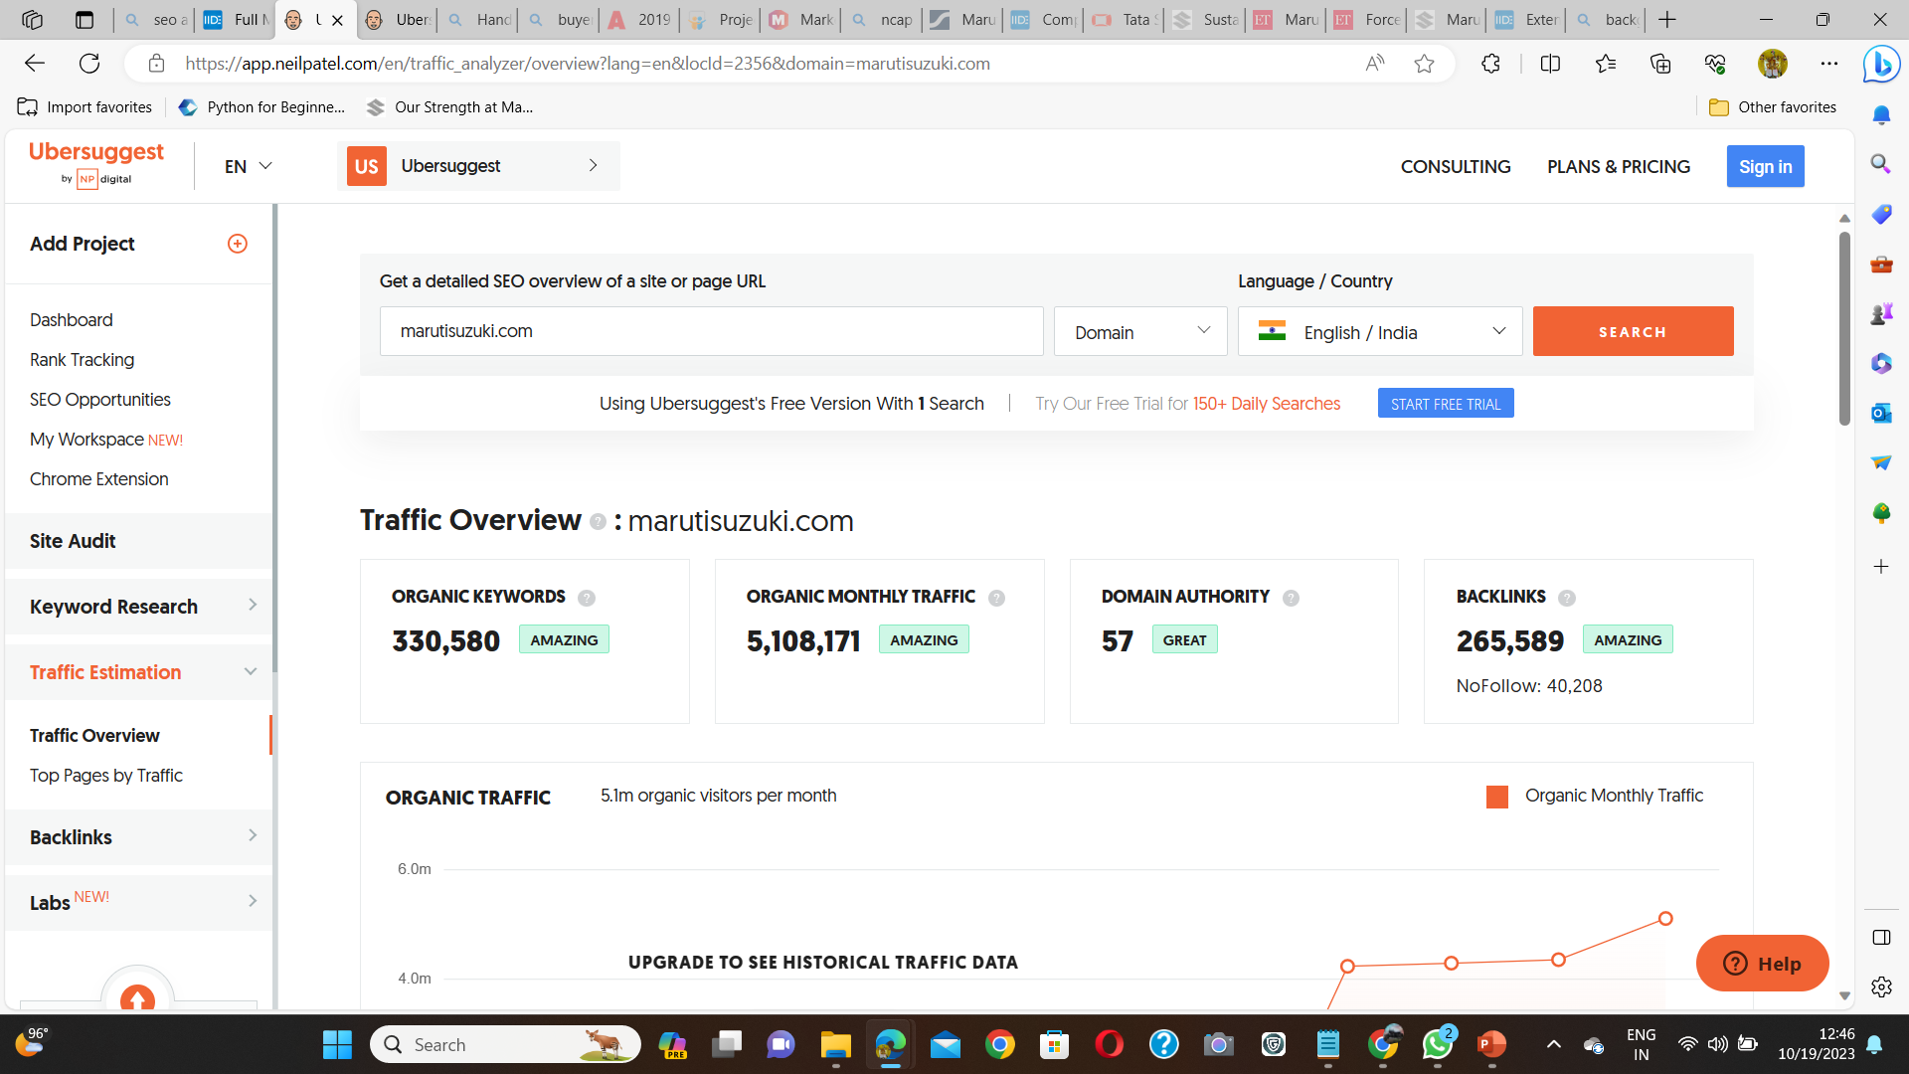
Keywords in URL (marutisuzuki.com)
The organic keywords for which Maruti ranks are 330,580, which is simply amazing. This shows how much effort Maruti has put forward for its SEO. The website gets a monthly traffic of 5,108,171, which is again brilliant.
It also gets 265,589 backlinks from other websites, which works as a backbone for Maruti in ranking no.1 on google search.
Below is the list of keywords for which marutisuzuki.com ranks.

Slide 15
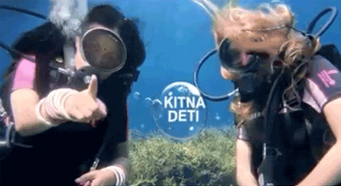
Marketing strategy
Marketing Strategy of Maruti Suzuki
Maruti Suzuki was among the first in the industry to study consumer behaviour and effectively respond to it. The company primarily adopted a market segmentation policy to meet the needs and demands of different sections of society.
Segmentation, Targeting and Positioning
Maruti Suzuki has a wide variety of models which meets every segment of the automobile market. It offers over 16 brands and about 150 variants spanning all segments which include Maruti 800, Maruti Omni, Maruti Alto, Maruti Gypsy, Maruti Wagon R, Maruti Swift, Maruti SX4, Maruti Ertiga, and Maruti Grand Vitara.
The brand has cars available for clients with an income of over 4 LPA. They cover the middle class, upper-middle-class, high class, and the affluent class which is its target customer base.
MSIL positions its 16 brands effectively by serving customers according to their specific needs and desires. From Alto and Wagon R to the premium Ertiga.
Kitna deti
The campaign sums up the Indian obsession with the value for
money received from a product/service which in the case of auto
refers to the mileage of a car. This was the advertisement video on
their youtube channel with the success of 24k+ views. , everyone
is covered!

Slide 16
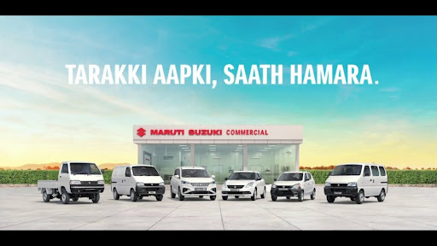
Tarakki Apki, Saath Humara
This campaign commemorates the channel’s success as a herald of growth, trust, transparency, and prosperity in meeting the customer’s business needs. The advertisement was successful on account that it helped instill in Maruti Suzuki being a trusted partner rather than a place to buy.
BE MONSOON READY
Through this campaign, the company offers complimentary checkups for their vehicles. Inspected by trained technicians to ensure safe monsoon driving. The advert will go a long way in showcasing the company as a responsible brand. Many customers showed interest in the offers to live a luxurious life.

Slide 17
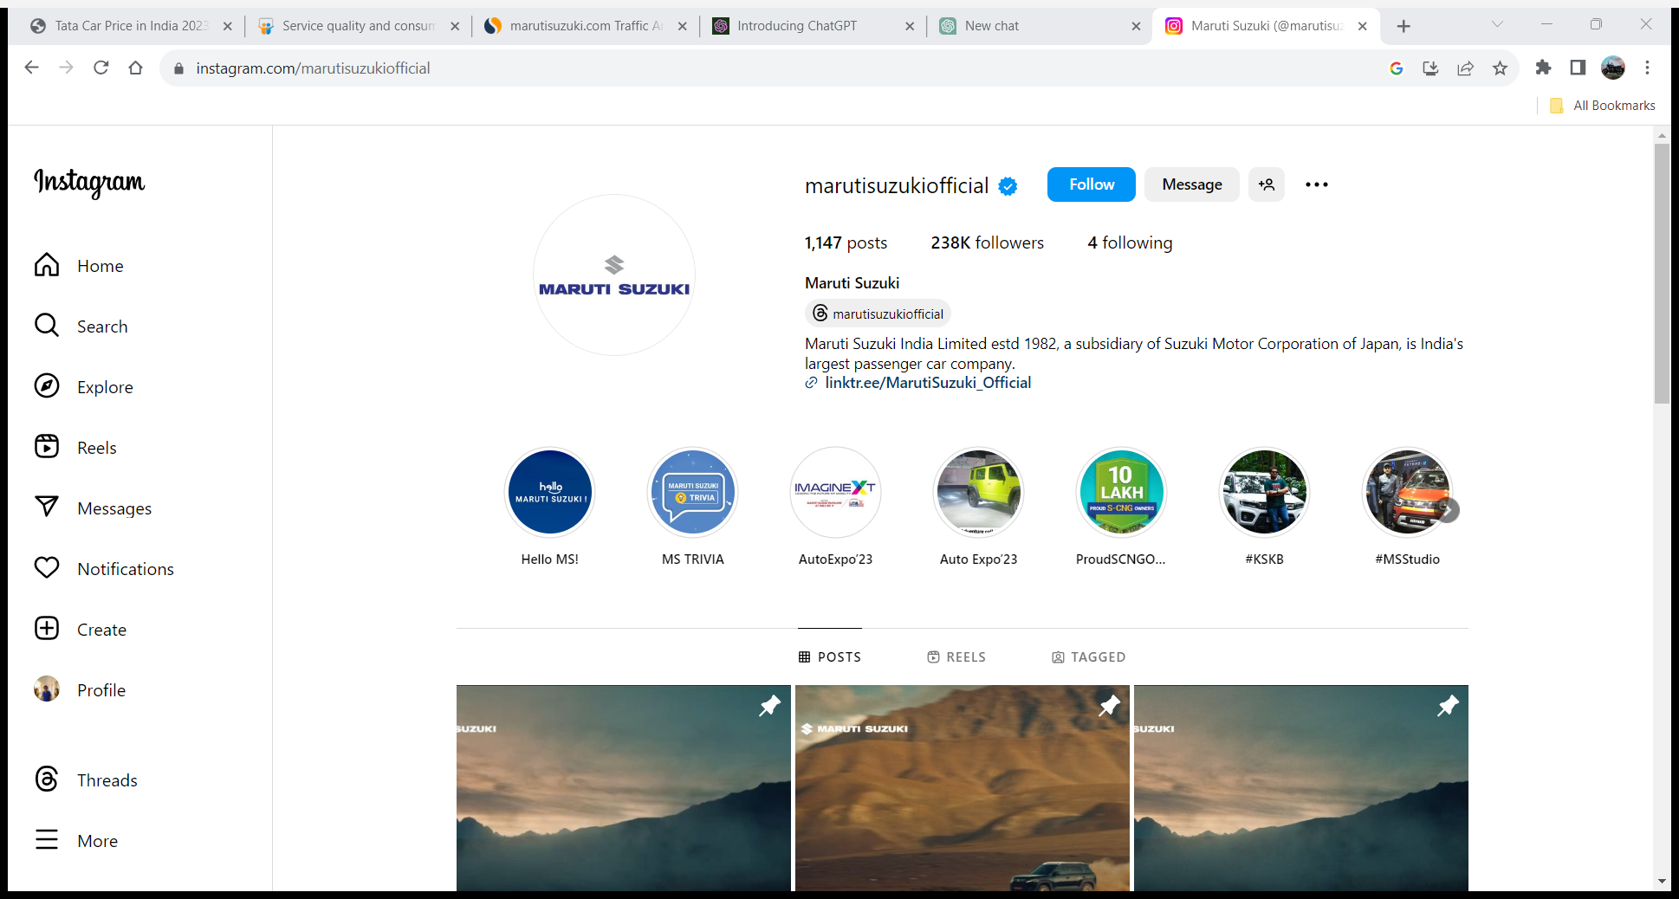
Social Media Marketing
Maruti Suzuki is very active in the social media space and has a good fan base across all major platforms like Twitter, Instagram, and Facebook. It has the highest number of followers on Facebook followed by Twitter and Instagram respectively. The marketing campaigns, brand offers, happy customer stories and many more are posted on their social media accounts.
Maruti Suzuki (@marutisuzukiofficial) • Instagram photos and videos

Slide 18
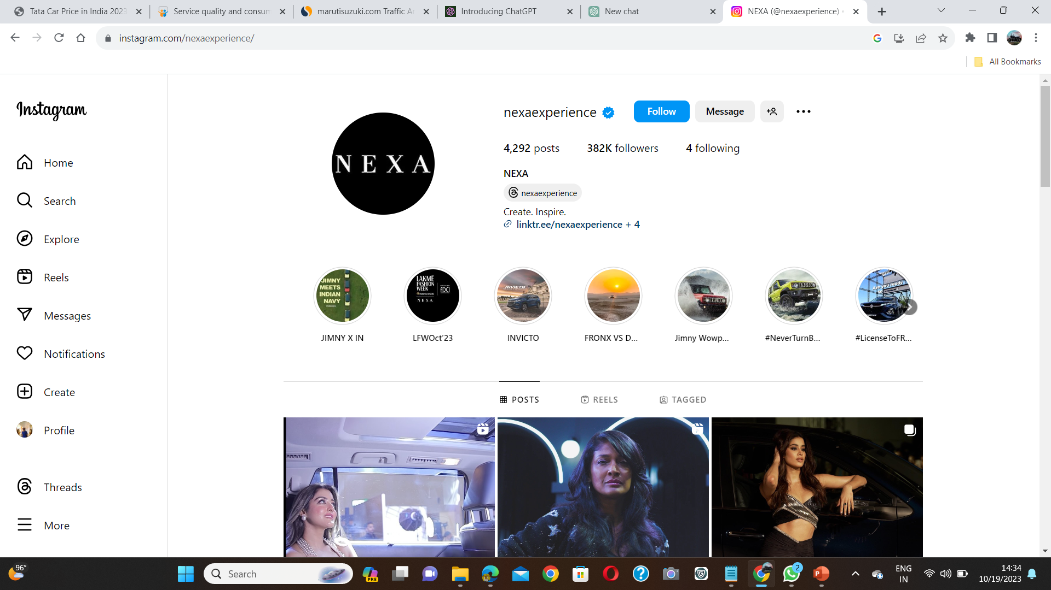
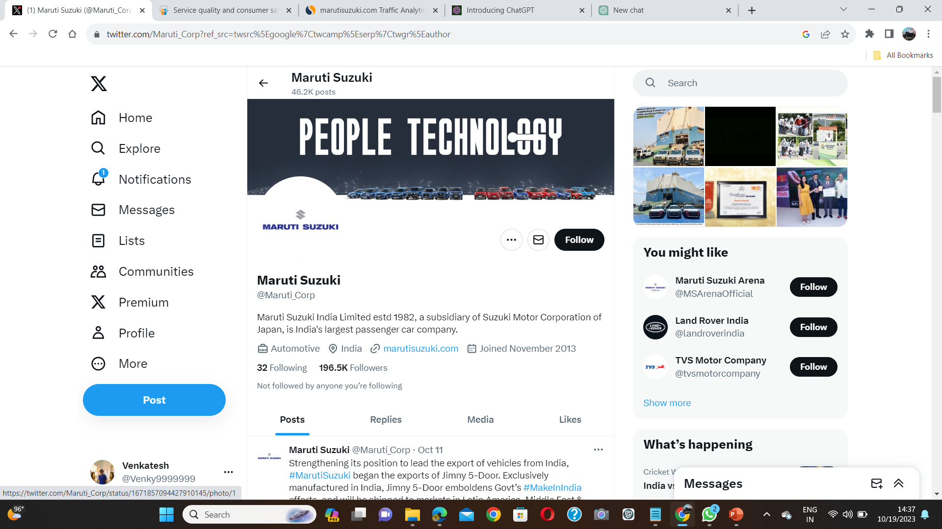
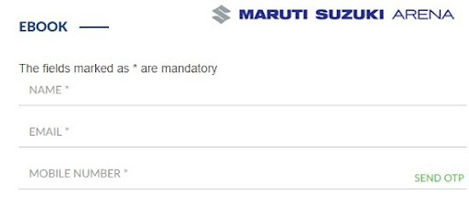
NEXA (@nexaexperience) • Instagram photos and videos
(1) Maruti Suzuki (@Maruti_Corp) / X (twitter.com)
It has two divisions as well Maruti Suzuki Arena which focuses on the showroom experience through technology, design, and Connected Experience, and the other which is Nexa which solely focuses on the premium segment of the brand Nexa models.
Ecommerce Strategies
The company began taking online bookings in 2017. In fact, in 2020, the company says it sold more than 2lakh cars through its online channel. Recently it introduced an end-to-end online real-time car financing program. The smart finance campaign has truly refined the modern car buying experience. The platform has addressed the issues regarding lack of proper information, lack of transparency, and lack of convenience and thereby helped stimulate sales for the company.

Slide 19
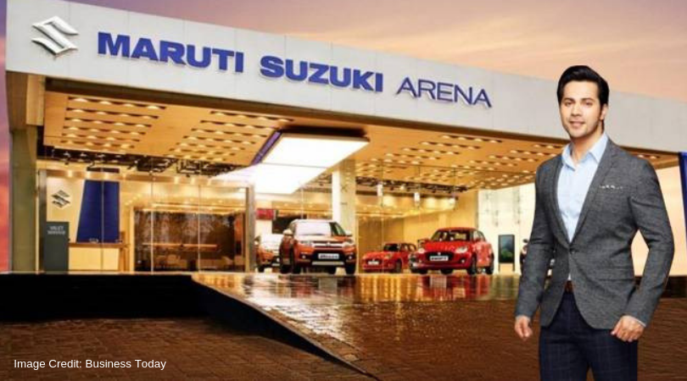
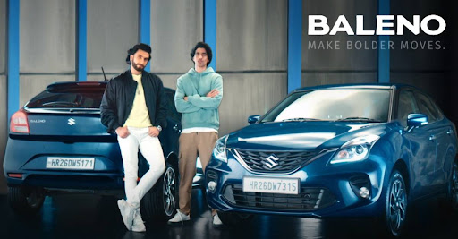
Influencer Marketing
Maruti Suzuki India (MSI) teams up with Bollywood star Varun Dhawan as brand ambassador for its Arena sales channel.
The ace brand retails models like Swift, Virata Brezza and Dzire from the Arena channel whereas others like Baleno, Ciaz and S-Cross are sold by the Nexa dealerships.
Beneath the Arena label, MSI is presently working on the makeover of its retail network across the country. The MSI Senior Director Marketing & Sales RS Kalsi said in a statement, “Varun exemplifies the evolving Indian youth who is trendy, social and confident and like to be connected at all times.” He also added that more than 100 new Maruti Arena Showrooms are by now ready in just one year of the launch of the initiative.
Maruti Suzuki signed a 2-year sponsorship deal with Ten Sports for the latter’s cricket rating property which is titled ‘Maruti Suzuki Cricket Ratings”. The company has roped in renowned Bollywood actor Ranveer Singh as its Nexa brand ambassador. It also has Varun Dhawan for Arena’s products in a move to connect with the younger audiences.

Slide 20
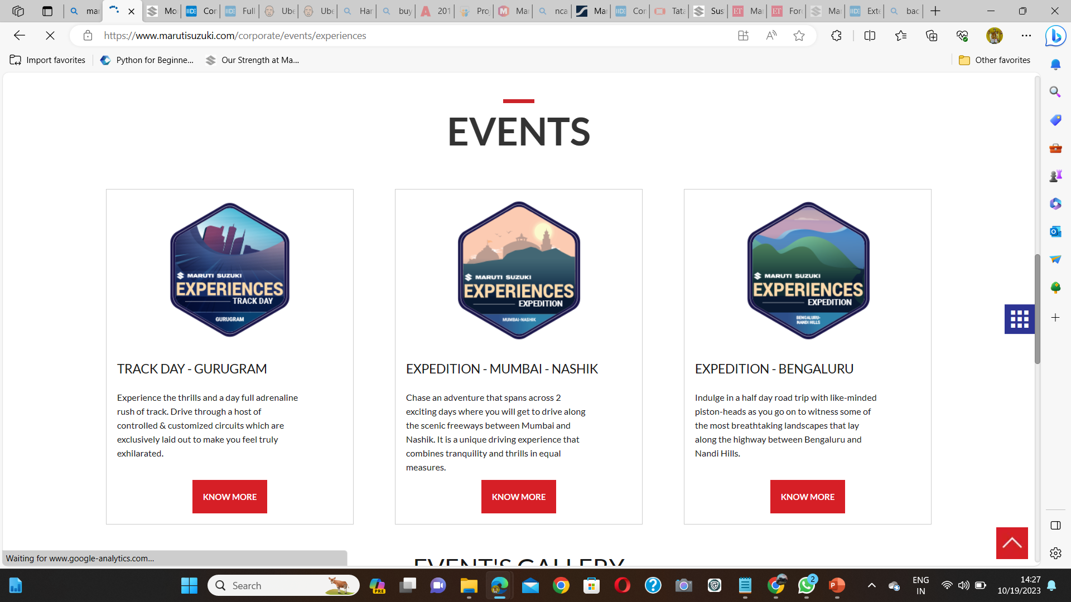
Content Marketing Strategies
The brand uses effective content marketing strategies to engage audiences by increasing their knowledge in the auto field to make rational buying decisions and thereby in the process portray the superiority and the value brought forward by MSIL cars. Multiple blogs and posts on both the company website and platforms like Twitter to educate users and show the added privilege of being their customer are showcased.
This ends our elaborative marketing strategy of Maruti Suzuki. Let us conclude our learning below from the marketing strategy of Maruti Suzuki.

Slide 21
Team members
TEAM ID : LTVIP2023TMID11831
P. Venkatesh
T. Pravallika
P. Manohar
S. Prasanth

Slide 22

